Slide 1
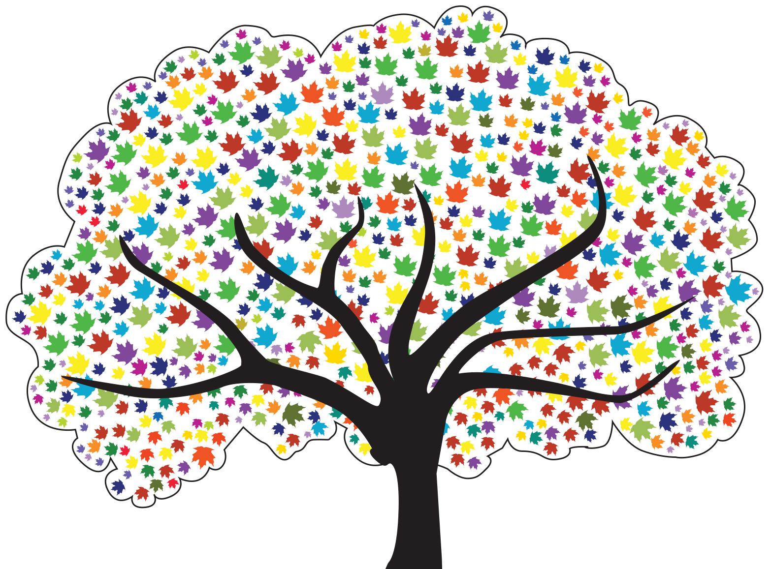
Meeting 4 Helping Children with Attachments

Slide 2
Video: Keema

Slide 3
The Basic Needs of Humans*
Making Dreams Come True
Self – Actualization
Self – esteem
Love and Belonging
Safety
Basic Survival
*Adapted from concepts developed by Abraham Maslow.

Slide 4
Definition of Attachment
Attachment is the affectionate and emotional tie between people that continues indefinitely over time and lasts even when people are geographically apart.*
* Fahlberg, Vera. “Attachment and Separation” PROJECT CRAFT, Training in the Adoption of Children with Special Needs. Ann Arbor, MI: University of Michigan School of Social Work, 1980, pp. V-1 - V-93.

Slide 5
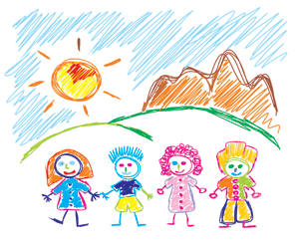
Why Attachment Is Important to Children
Attachment helps children:
Develop a conscience (moral/spiritual development)
Become independent (social development)
Deal with stress, frustration, fear and worry (emotional development)

Slide 6
Why Attachment Is Important to Children (continued)
Attachment helps children:
Think logically (mental development)
Develop future relationships (social development)
Grow physically and develop health (physical development)

Slide 7
Cycle of Need: Attachment
Need Survival–Food
Expression
(Behavior) Cry
Intervention Feed Infant
Relaxation
Trust
Attachment
Secure

Slide 8
Cycle of Need: Mistrust
Need
Expression (Cry)
Intervention (Ignore, Slap)
Anxious Angry Fearful
Mistrust

Slide 9
Promoting, Building, Rebuilding and Supporting Attachments
Select a group facilitator and a reporter
Read your case example
Answer the questions
Be ready in 15 minutes

Slide 10
Roadwork
Complete Strengths/Needs Worksheet and Feedback to the Leader(s) – bring to Meeting 5
Review Meeting 4 handouts
Be prepared to tell the group about 3 behaviors that “push your buttons”

